Slide 1
Project Proposal: YourTitleHere
FirstName LastName
StudentNumber

Slide 2
Table of Contents
Value Proposition: What computer vision application will you make and why is it’s added value?
Proof-of-Concept: How will my Computer Vision Algorithm work?
Explainable AI: How does my AI work?
Responsible AI: Why is my AI ethical?
Disruptive Technology risks: What disruptive technology risks am I facing?
Application Design: How will my computer vision application work?

Slide 3
Value proposition
Business Understanding Components
AI Canvas
Do market research & consumer analysis
Is the proposal feasible?
ILO Mapping: Which parts of ILO 2: business understanding should be covered in these slides?

Slide 4
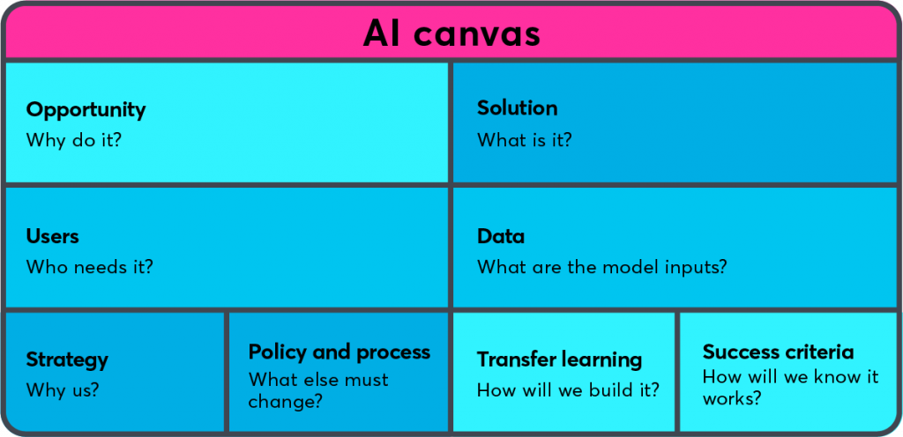
AI Canvas

Slide 5
Proof-of-Concept: Computer Vision
Present the model which best fits your use-case
Baseline AI Algorithm Design
Improvement steps
Transfer Learning + Tweaking
Overall Performance Evaluation
Etc.
ILO Mapping: Which parts of ILO 4: neural networks and deep learning should be covered in these slides?

Slide 6
Responsible AI
Bias, fairness, transparency and interpretability
ILO Mapping: Which parts of ILO 3: Responsible and Explainable AI should be covered in these slides?
(Presentation) Requirements:
Perform an EDA on the dataset with the goal to identify, and describe an instance of bias in the Imsitu dataset.
Discuss a possible ramification (e.g., harm) in terms of fairness of the identified bias instance in the Imsitu dataset.
Ask Nitin --> Add 'Apply Explainable AI method' requirement.

Slide 7
Disruptive Technology Risks
Risks
Contingency Plan
Donald Trump tries to start an insurrection using my app
ILO Mapping: Which parts of ILO 2: business understanding should be covered in these slides?
ILO Mapping: Which parts of ILO 5: Human Centered AI: User Experience should be covered in these slides?
Have a constitution and a work rule-based state

Slide 8
HCAI - Application Design:
High-level design:
Concept:
Who is the user?
What problem are you solving?
How is the app going to solve that problem?
Menu Flow?
Information flow?
Colors styles?
Interaction style?

Slide 9
HCAI - Application Design
Algorithm Embedding:
How is the computer vision algorithm embedded?
What will the eventual algorithm classification and how?
Will the algorithm be able to do more then demonstrated in the proof-of-concept?

Slide 10
HCAI - Application Design:
Continuous Learning
How does the application design allow for continual (supervised) learning based on user input? Meaning users can label data and/or output, E.g.:
annotate pictures;
other data labelling means;
rate predictions/model output.

Slide 11
HCAI - Application Design:
Feedback
User tests results?
Client feedback?
What was processed and how?
Design implications?

Slide 12
HCAI - Application Design:
Low-level design:
Detailed design of the application
Everything which doesn’t fit into the other boxes usually goes here…
Note that you might want to explain aspects of the low-level design using your wireframe if possible!
E.g.
User will receive notifications to do…
To improve user retention, a competitive system is introduced which does…
To warn the player for Y, a yellow colour will be used for X

Slide 13
HCAI - Application Design:
Wireframe Prototype:
Some demo…
Link to .zip file of exported prototype on github

Slide 14
Any questions?

